Slide 1
Welcome!
Please edit this presentation as much as you like, we have just given you some ideas about what you could include, based on ideas from one of our Young Champions.
Some of the slides include our suggestions, which have been written like this.
Add in pictures of your own to make it more interesting.
Have fun!

Slide 2
Coeliac Disease
<Put your name here!>

Slide 3
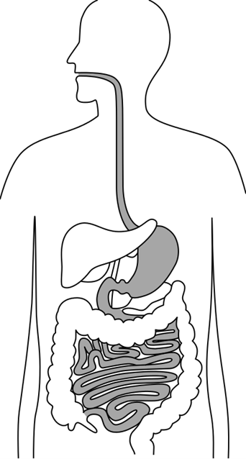
What is coeliac disease?
When someone with coeliac disease eats something called gluten, their body reacts by damaging the insides of the small intestine.
If you have coeliac disease it never goes away.
1 in 100 people has coeliac disease.

Slide 4
What happens?
If people with coeliac disease eat gluten they might:
Feel poorly
Have tummy ache
Have headaches
Lose weight
Feel tired all the time
Have mouth ulcers

Slide 5
Why?
If your insides are damaged because of gluten, you can’t soak up all the goodness from your food. That’s what makes you feel poorly.
When you stop eating gluten you will get better.
But if you eat gluten you will feel poorly again.
There is no medicine to make someone with coeliac disease better, it is all about changing the food they eat.

Slide 6
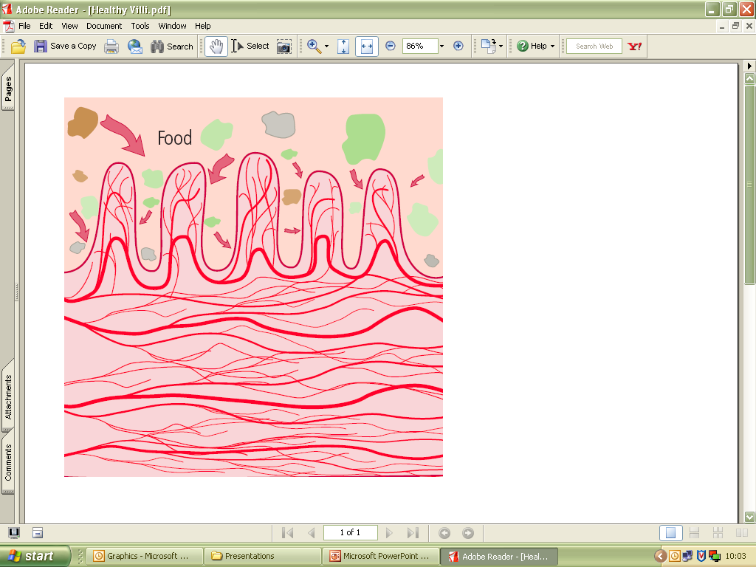
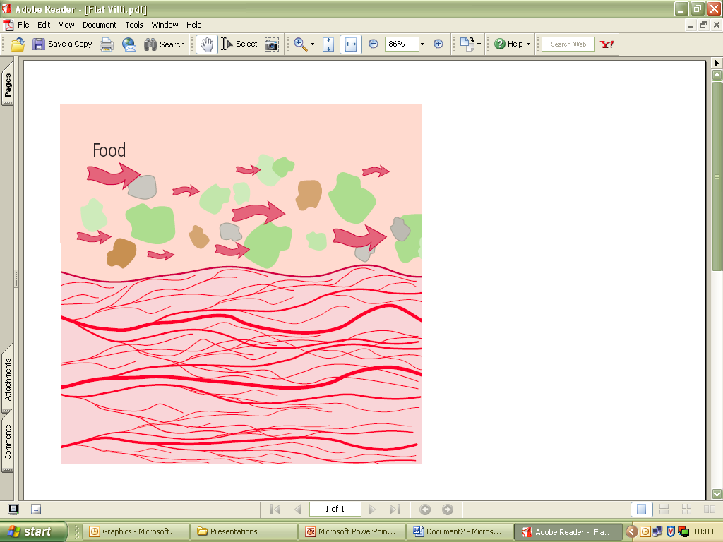
Why?
This is what a healthy tummy looks like
This is what a tummy damaged by gluten looks like; it can’t soak up food properly.

Slide 7
All about Gluten
Gluten is found in some of the grains we eat, called wheat, rye and barley.
These are often ground down to make flour, which is in a lot of the foods we eat.
Bread, pasta, pizza, crackers, cakes and lots of breakfast cereals contain gluten.
Some people with coeliac disease also get poorly when they eat oats.

Slide 8
My story
Tell your friends how you felt before you found out you had coeliac disease.
How did it make you ill?
How did the doctors find out what was wrong?
How long did it take for you to feel better?
You can add in as many slides as you like. It might be a good idea to include “before” and “after” pictures if you have them!

Slide 9
Gluten free diet
It can sometimes be tricky to tell if food is OK to eat
Wheat, barley and rye can be included in foods you wouldn’t normally think of
You might not expect sausages, brown sauce, chocolate bars or ice cream to contain gluten – but some do!
You could play the “guess what is gluten free” game in the Young Champions Pack

Slide 10
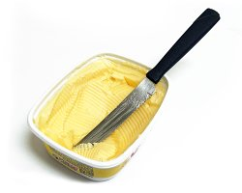
Why is it difficult?
What happens to you if you accidentally eat gluten?
How do you try and make sure you don’t?
For example, “At home my food is made separately and I have my own butter and jam in the fridge.”
What foods do you miss? Ask your friends what they would miss if they had to stop eating them!

Slide 11
How do I know what I can eat?
Do you or your parents check food labels?
In some parts of the country the doctor can give you a prescription for gluten free food – do you get this?
Do you like the special gluten free bread you can get in the shops?
Do you have special recipes for cooking gluten free food at home?

Slide 12
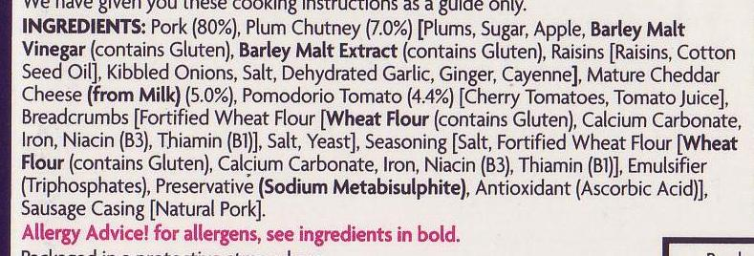


Food labels
We think these are quite good pictures to explain about how you check a food label, and about the Crossed Grain symbol.

Slide 13
What makes it easier?
People need to know that I am not being a fussy eater, my gluten free diet is really important to keep me healthy
What do you find difficult about the gluten free diet?
How can your friends help?

Slide 14

Thank you for listening!
Any questions?

