Slide 1

Coeliac Group Update
2018
Catherine Tancock

Slide 2

Why do I have Coeliac Disease?
Gluten Free Prescribing in England
Vitamin D and calcium requirements
DXA scan
Annual review
Screening
Vaccinations

Slide 3
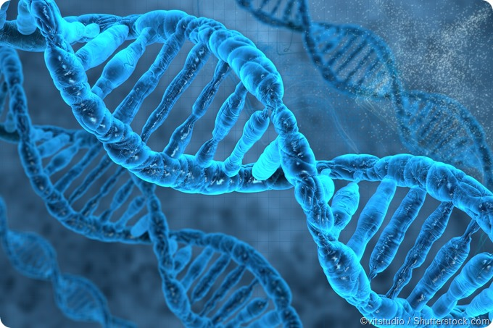
Why do I have Coeliac Disease?
Early history
Evolution
Genetic
Immunology

Slide 4
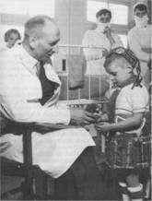

History
Samuel Gee (1887) is credited with the first clinical description of coeliac disease
Coeliac disease was first described by Aretaeus of Cappadocia 10,000 years ago
Dr Willem Dicke found that some malnourished children with coeliac disease improved during the Dutch Famine (1944-45) but deteriorated when bread was reintroduced
A connection was made between wheat and coeliac disease
He put 3 patients on a balanced diet with/without wheat starch which led to the discovery of the cause of coeliac disease and the first gluten free diet
The early 1960’s saw the discovery of the antigliadin antibodies and was the first non invasive serology markers for coeliac disease

Slide 5

Evolution
It is considered that civilisation occurred due to improved nutrition related to the domestication of wheat
Our common bread wheat evolved from wild einkorn wheat and goat grass leading to emmer wheat which is the first known domesticated wheat.
The proteins in wheat caused an immune reaction in coeliac patients

Slide 6
Genetic
A palaeodiet reconstruction (2010) and bone analysis on a skeleton of a young Italian woman from 1st century AD with malnutrition, stunted growth with probable iron deficiency - found the HLA DQ2 gene present and is the first documented case of coeliac disease
There are over 40 genes associated with coeliac disease with evidence that positive selection of ‘harmful’ genes has occurred to help respond to bacterial or infections organisms (links to Justinian Plague 1400 years ago!)

Slide 7
Why is Coeliac Disease on the rise now?
Coeliac disease started to increase in the 1980’s – why?
Is it due to an increase in wheat consumption?
NO – wheat consumption peaked in the1880’s
Is it due to ‘toxic’ modern wheat?
NO – modern wheats are less immunogenic
Maternal wheat intake or breast feeding ?
NO evidence
Infant gluten consumption?
NO evidence re timing of introduction of gluten
Dietary patterns after weaning?
? A normal healthy diet may reduce development of CD –more studies
Microbiome?
NO evidence of early introduction of antibiotics
Caesarean section?
NO association with c section and vaginal deliveries

Slide 8
Immunology: Associations
Hook worms – do they protect?
Coeliac patients infected with hook worms
and reintroduced to gluten had no
deterioration in their condition ☺
Flu virus – 30% increase risk of developing CD 1-2 years post virus
Rotavirus – 40% risk reduction in children after vaccination ☺
Reovirus infection – triggers inflammatory responses to dietary antigens and development of CD

Slide 9
Conclusions:
The origins of CD lie in the origins of agriculture and the birth of human civilisation
Gene variants associated with CD have persisted due to balancing or positive selection driven by infectious diseases
CD has become more common in the late 20th century
We still don’t really know why
Viral infections are likely to play a role in triggering CD
A vaccine in America is in phase 2 of study and is looking promising.

Slide 10
Gluten Free Prescribing in England
National consultation with over 8000 responses, 1000 from healthcare professionals
Consultation response published in February 2018 recognising and acknowledging concerns re cost, availability, adherence and support
The government’s preferred option is to retain a limited range of bread and mix products on prescription

Slide 11
CCG’s
127 CCG’s including NEW Devon CCG have already altered the way they prescribe. NEW Devon have stopped all adult prescriptions for gluten free products
The consultation outcome does not require them to reverse this decision. NEW Devon haven’t commented on whether they will change as yet.

Slide 12
Next Steps
Task and Finish Group has been formed with the BDA, Coeliac UK, RCGP, RCPCH and manufacturer involvement.
‘to provide advice to the Department on implementing the changes to the availability of GF food in primary care. This will include, but not limited to; product list streamlining, pricing, suitability of products for a range of patients, update to the clinical indication, appropriate communications and alternative supply routes’

Slide 13
Alternative Models
Improving the existing model ie GP prescription taken to pharmacy
Pharmacy led
Dietitian led
Pharmacy voucher
Supermarket voucher
Annual top up card for GF products – keep spend under control.

Slide 14
What do we do next?
Coeliac UK are contacting all CCG’s identifying where access has been restricted and challenging CCG’s to review and reverse these decisions.
The BDA are supporting these efforts by providing local dietitians with materials to help them approach their local CCG’s

Slide 15
Vitamin D – new recommendations
Vitamin D helps the body absorb calcium and is needed to keep bones and teeth healthy
It is made by the skin when exposed to sunlight and it is found in oily fish, egg yolk, meat, offal, milk fortified margarines/breakfast cereals and cod liver oil.
Public Health England recommend everyone in the general population over the age of 4 to take a daily supplement of 10 micrograms of vitamin D from October to February.
There are no specific recommendations on vitamin D intake for people with CD. Current advice is the same as for the general population

Slide 16
Vitamin D continued
On average 19-64 year olds consume a third of their daily recommended intake
Adults can develop osteomalacia ( soft bones, bone pain and muscle weakness) if they do not get enough vitamin D
Supplements are widely available to buy from pharmacies, supermarkets and health food shops
If you are already on a calcium supplement – check it isn’t already combined with vitamin D, it is important not to have more than 1 supplement containing vitamin D.
There is no problem taking a vitamin D supplement alongside spending time in the sun as the body will only make what it needs.

Slide 17
Calcium
People with CD may have an increased need for calcium compared to the general adult population
Adults with CD should have at least 1000mg calcium/day compared to 700mg for the general population
If you can’t get all the calcium you need from your diet and your calcium levels are low you may need to take a calcium supplement. Speak to your doctor or dietitian for further advice
Your consultant will be able to advise if you require medication (biophosphates) to lower the risk of bones breaking, this will usually follow a DXA scan

Slide 18
High calcium containing foods
200ml skimmed milk
200ml s skimmed milk
½ can tinned sardines
30 g cheddar cheese
2 tsp sesame seeds
125g pot yoghurt
½ tin baked beans
1 orange
3 tblsp broccoli
248mg
244mg
230mg
220mg
170mg
170mg
105mg
70mg
32mg
Portion size of food
Calcium content/portion

Slide 19
DXA scan
If you have coeliacs disease you are identified as high risk of developing osteoporosis and fragility fractures
DXA scans are offered to:
>50 yrs with a history of fragility fractures
<40 yrs with a major risk factor eg CD
Other groups with a 10 yr fragility fracture risk of 10%
Repeat scan appropriate to individual but usually within 2 years

Slide 20
Annual review (GP)
The following should be covered:
Ensure adequate advice and information on CD and gluten free diets have been received and assess adherence to diet
Assess for symptoms and signs of CD, its complications and associated conditions eg GI symptoms, BMI, osteoporosis risk
Consider annual blood testing
If diarrhoea and/or other symptoms recur or persist on a strict GF diet consider diagnosis
Referral back to gastroenterologist if there are signs of complications/persistent symptoms
Referral to dietitian if it’s difficult to asses adherence to GF diet
Offer immunisations
Offer more frequent review if there is a clinical need eg pregnancy

Slide 21
Screening
CD fulfils many but not all of the WHO criteria for screening.
There is insufficient evidence to recommend population screening however testing should be carried out on:-
Symptomatic first degree relatives (10% prevalence)
High risk groups – iron deficiency anaemia, Down’s syndrome, T1 Diabetes, osteoporosis and IBS (2-5% prevalence)

Slide 22
Pneumococcal Vaccination
Some people with coeliac disease have been found to be hyposplenic potentially putting them at risk of pneumococcal infections.
Based on advice from the Health Advisory Council (HAC), Coeliac UK recommends that everyone with coeliac disease is vaccinated against pneumococcal infection
The BSG Guidelines for the diagnosis and management of adult coeliac disease (2014) recommend patients newly diagnosed with coeliac disease have the pneumococcal vaccine, this is a one off injection.

Slide 23


